Slide 1
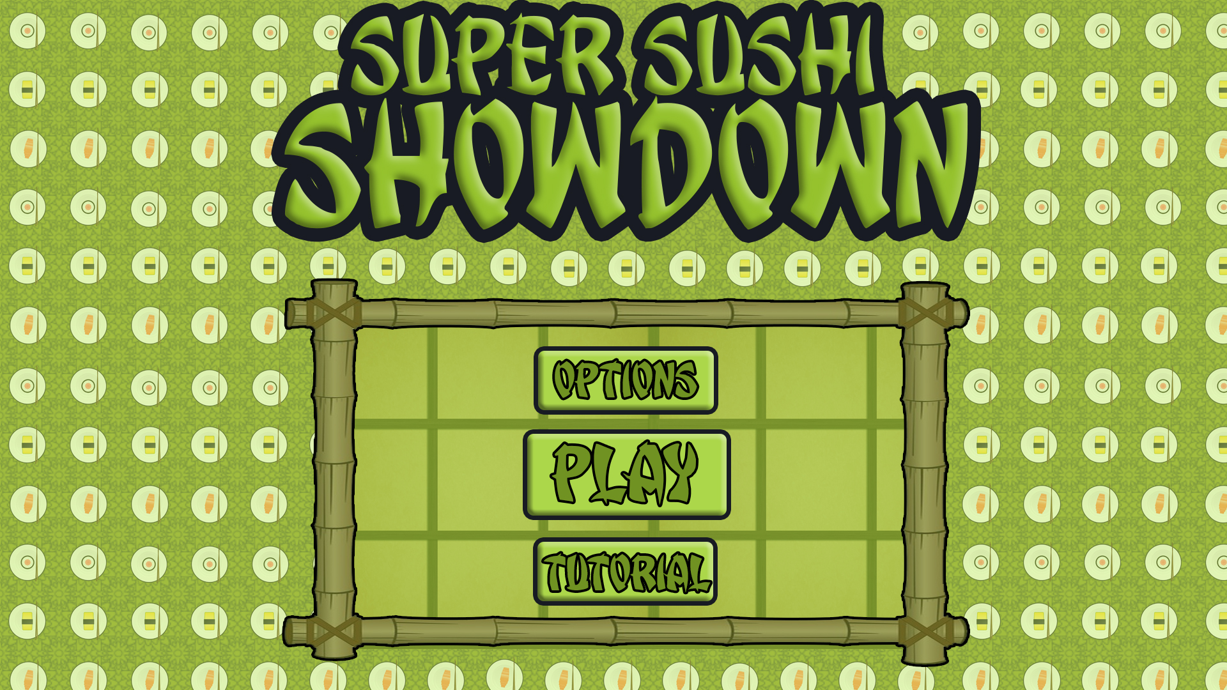
Level 4/5 – Group 5
Bandi Namco Third Pitch
Henry Crofts, Ashley Long, Samuel McMillan and Dawid Hojka

Slide 2
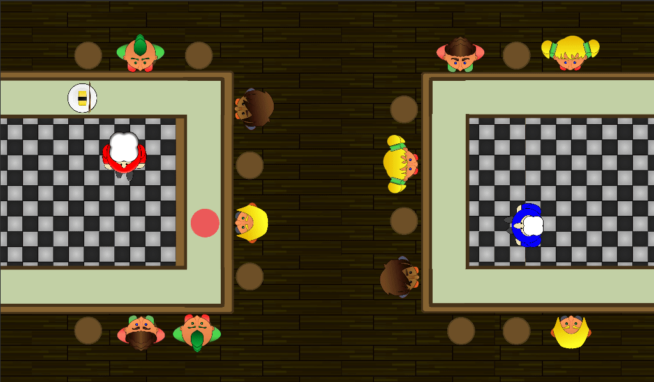
Latest version

Slide 3

node changes
“The speed the sushi moves at is quite slow”
Increase the speed of sushi
“The sushi was hard to tap, kept missing”
Increased the size of sushi colliders
Adjusted the raycast layer

Slide 4
Negative feedback loop
Why did we implement this?

Slide 5
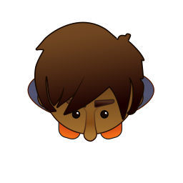



Score confusion
“Who is winning?
Use customers to display score

Slide 6




Added animated feedback
“I’m not really sure if I’m hitting the node correctly”
Added animated chefs pop ups

Slide 7
Powerups

Slide 8
Playtesting video
Add video here! YouTube link?

Slide 9
Upcoming changes / polish

Slide 10
Questions?

